Slide 1


Company Name and Logo
Your Company
Cybersecurity Training
Protect yourselves online by mastering cybersecurity
best practices
Week 3
www.YourCompany.com
Notes:
Show this training slide before training

Slide 2


Let's Review
Device Protection
Notes:
Ask the attendees: "Let's see what you have remembered from last week... who can tell me something about... "
Depending on how much you have, you will ask them about the concepts below. If a concept is not clear, refresh their memory before moving on.
A - Device Protection
1. Passwords and Best Practices
2. Avoiding Risky Downloads and Attachments
3. Screen Lock
4. Outdated Software

Slide 3


What will we be discussing
Social Engineering
Mobile Device Security
Notes:
Summarize the topics which will be covered in this session
- Social Engineering and
- Mobile Device Security

Slide 4

Social Engineering
Notes:
In the next section, we will discuss what social engineering is.
Let them know that this will be that some concepts and protection measures discussed earlier fall into this category of knowing how to protect yourself.

Slide 5

Social Engineering
Manipulation to reveal sensitive information
Notes:
Social engineering is manipulating or tricking people into revealing sensitive information or taking harmful actions"

Slide 6
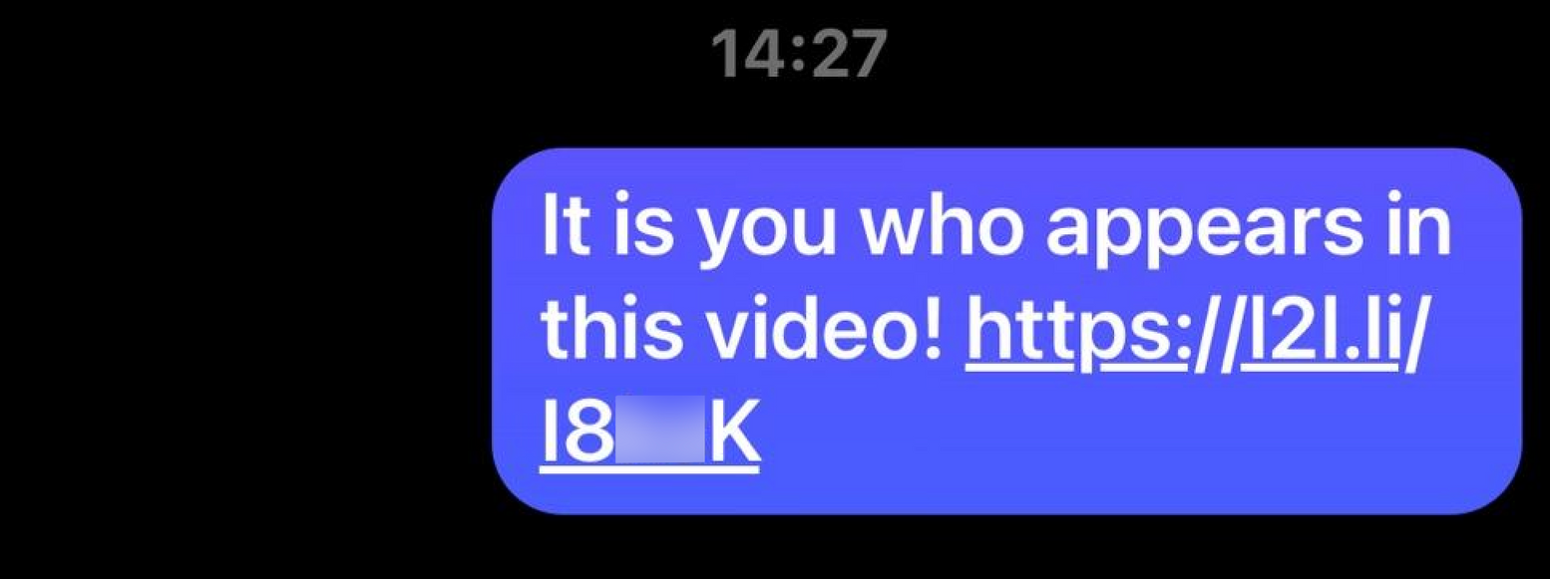
Social Engineering
Example:
Notes:
Show the attendees this screen, and let them know this is an example of a social engineering attack that comes via different kinds of messenger apps.
Let them know that clicking on this link can make you fall victim to a cyber attack.

Slide 7
Social Engineering
Point of Entry
Social Media
Emails
Phone Calls
SMS messages
and many more...
Notes:
Explain that social engineering comes in many forms. Even outside of working hours.
I. They use different method to manipulate you.
II. If it's too good to be true, chances are it is.
III. Let them know that they use the following tools to gain information.
The use of the following:
- Social Media
- Email
- Phone calls
- SMS messages
- and many more tools posing to be legit.

Slide 8
Social Engineering
Social Media
Gather Information
Send infected files or links
Pose as trusted resource
Include attachments to their messages
Notes:
Explain the following instances on how hackers can get your information through social media.
I. Cybercriminals can use social media platforms to collect information about individuals and organizations, which they can then use to launch targeted attacks.
II. Send infected files or links that can infect your computer or device.
III. Scammers may pose as trusted sources, such as banks or government agencies, and ask individuals to provide sensitive information, such as login credentials or social security numbers.
IV. They may also include links or attachments in their messages that, when clicked, can download malware unto the victim's device.

Slide 9
Social Engineering
Types of Attacks
Phishing
Spear phishing
Pretexting
Baiting
Tailgating
Evesdropping
Notes:
Explain the following.
Though a bit technical, let them know that these concepts will help them understand what may happen in various scenarios.
I. Phishing is an attack where an attacker sends a fraudulent email or message, often impersonating a legitimate source.
II. Spear phishing - a phishing attack targeted at a specific individual or group, often using personal information to make the message seem more legitimate. -- These attacks are more sophisticated and challenging to detect than traditional phishing attacks.
III. Pretexting - is a type of attack where an attacker creates a false scenario or pretext to gain access to sensitive information.
IV. Baiting - an attack where an attacker offers something of value in exchange for sensitive information or access to a computer or network. This can be done physically, such as by leaving a USB drive or offering a fake software update.
V. Tailgating - is a social engineering attack where an attacker follows closely behind a legitimate user to gain access to a restricted area or building. Locking your screen is a good practice to prevent this.
VI. Eavesdropping is an attack where they intercept communications, such as phone calls or messages.

Slide 10
Social Engineering
Techniques
Authority
Urgency
Scarcity
Familiarity
Trust
Notes:
Explain the following techniques hackers may use to gain information.
I. Authority - attackers may impersonate someone in a position of authority, such as a boss, IT administrator, or government official, to gain trust and compliance from their target.
II. Urgency - They may create a sense of urgency, such as a deadline or a threat of consequences, to pressure their target into taking action.
III. Scarcity - Attackers may create a sense of scarcity, such as a limited-time offer or a limited quantity of a product, to encourage their target to act quickly.
IV. Familiarity - Attackers may use personal information about their target, to create a sense of familiarity and build trust.
V. Trust, They may build trust with their target over time, using a series of small requests or interactions, to eventually gain access to significant information or resources.

Slide 11
Social Engineering
Countermeasures
Employee Awareness
Security policies and procedures
User authentication
Security software
Notes:
This next section are some countermeasures against social engineering.
Explain the following countermeasures that are used in preventing social engineering attacks.
I. Employee awareness - By educating employees on the different types of these attacks, how to recognize them, and how to respond to them, organizations can help to reduce the risk of successful attacks.
II. Security policies and procedures - can help prevent social engineering attacks by providing clear guidelines on handling sensitive information and responding to suspicious messages or requests.
III. User authentication is critical, requiring users to provide multiple forms of authentication; organizations can help reduce the risk of successful attacks.
IV. Security software can help to prevent attacks by providing additional layers of protection and detection.

Slide 12
Social Engineering
Prevention
Attachments
Legitimate source
Be skeptical and vigilant
Reporting
Notes:
Social engineering attacks can also be prevented.
Discuss the following ways to prevent these attacks.
I. Attachments - Be cautious of clicking links or downloading attachments from unknown or suspicious sources. When receiving an email with an attachment or link you weren't expecting, taking extra precautions before clicking on it is essential.
II. Legitimate Source - Check if it is a legitimate source, Cybercriminals may use fake websites or email addresses to trick users into providing sensitive information or downloading malware.
III. Be skeptical and vigilant - Be cautious of suspicious messages, emails, or phone calls, and never provide sensitive information to unknown sources. If an offer seems too good to be true, chances are it is.
IV. Reporting - reporting suspicious emails can help prevent cyber attacks and protect your organization's sensitive data

Slide 13
Mobile Device Security
Notes:
In the next section, we will discuss some best practices for device protection.
Let the attendees know that some of the topics and concepts discussed earlier can be used in various situations and devices. Not only on their office computers but on their home and mobile devices.
Let them know that some of the topics will be a short repeat of what was discussed previously.

Slide 14
Mobile Device Security
Software update
Passwords
Biometric authentication
Notes:
Discuss the following device protection measures.
I. Software update - Keeping your mobile device software up to date often include critical patches for vulnerabilities and bugs that cybercriminals could exploit. Cybercriminals always look for vulnerabilities, and outdated software is a prime target.
II. Passwords - Use complex passwords and avoid reusing the same password across different accounts. Consider using a password manager to create and manage your passwords.
III. Biometric authentication - Many mobile devices now include biometric authentication methods like fingerprint or facial recognition. These methods can provide an additional layer of security to your device.

Slide 15
Mobile Device Security
Security software
Public WiFi
Messages or request
Third Party apps
Notes:
Continue adding more information on protecting their devices.
I. Installing antivirus software on your mobile device can help to detect and remove malicious software that may be used in cyber attacks.
II. Public Wi-Fi networks are often unsecured and can be easily hacked by cybercriminals. Avoid using public Wi-Fi networks for sensitive activities like online banking or shopping. If you must use a public network, use a virtual private network (VPN) to encrypt your internet connection and protect your data from prying eyes.
III. Be cautious of suspicious messages or requests you receive on your mobile device, such as phishing emails or messages asking for your personal information. Never provide sensitive information to unknown sources.
IV. Be cautious of third-party apps that you download on your mobile device—only download apps from trusted sources, such as the Apple App Store or Google Play Store.

Slide 16
Questions
Notes:
Ask the training attendees if they have any questions that need to be addressed.
Open this section for interactive discussion.

Slide 17
Recap and Takeaways
Notes:
Review what the attendees have understood and ask around what they have learned.
Ask them for a takeaway from today's session.
Asking around reinforces what they have learned and can also teach others.

Slide 18

Company Name and Logo
Thank you
for your attention
www.YourCompany.com
Notes:
Thank the attendees and congratulate them for completing this session.
Let them know to review the materials provided and that they can ask questions after this training session.
Remind them of the next session date and time.

